Slide 1
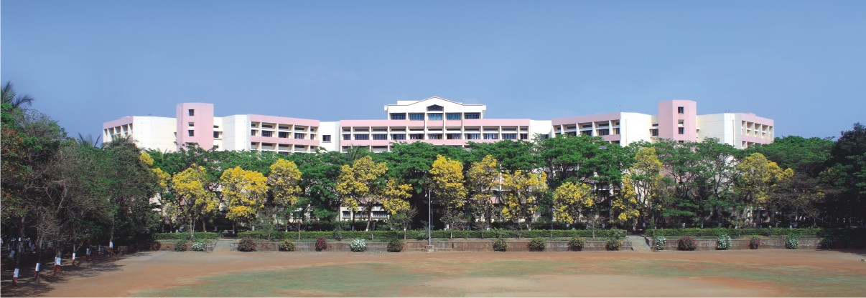

K.K.WAGH INSTITUTE OF ENGINEERING EDUCATION & RESEARCH
PROJECT STAGE -II Sign-to-Speech Conversion
Group Id 27
Internal Guide Prof. N. M. Shahane
Notes:
NOTE:
To change the image on this slide, select the picture and delete it. Then click the Pictures icon in the placeholder to insert your own image.

Slide 2
TEAM MEMBERS
Division/ Roll No. | Exam Seat No. | Name of the student
B-33 | B150134351 | Shubham Zope
B-34 | B150134331 | Sanket Sonar
B-35 | B150134350 | Abhijit Watpade
B-36 | B150134319 | Sameer Rathod

Slide 3

Content
Problem Statement
Design
Tools and Techniques Used
Implementation
Results
Conclusion and Future Scope
Cost Analysis
References

Slide 4
Problem Statement
To create a computer software and train a model using CNN which takes image of hand gestures of American sign language and shows the output of particular sign language in text format format and converts it into an audio

Slide 5
Tools and Techniques Used
Python for implementation.
Adam optimizer for fast Gradient Descent calculations and adjusting the learning rate effectively.
ImageDataGenerator for creating the wide variety of data from existing data with data augmentation.
OpenCV for sign language image collection.
Keras for Deep Learning.
TKinter for frontend.
Google colab for model creation.

Slide 6
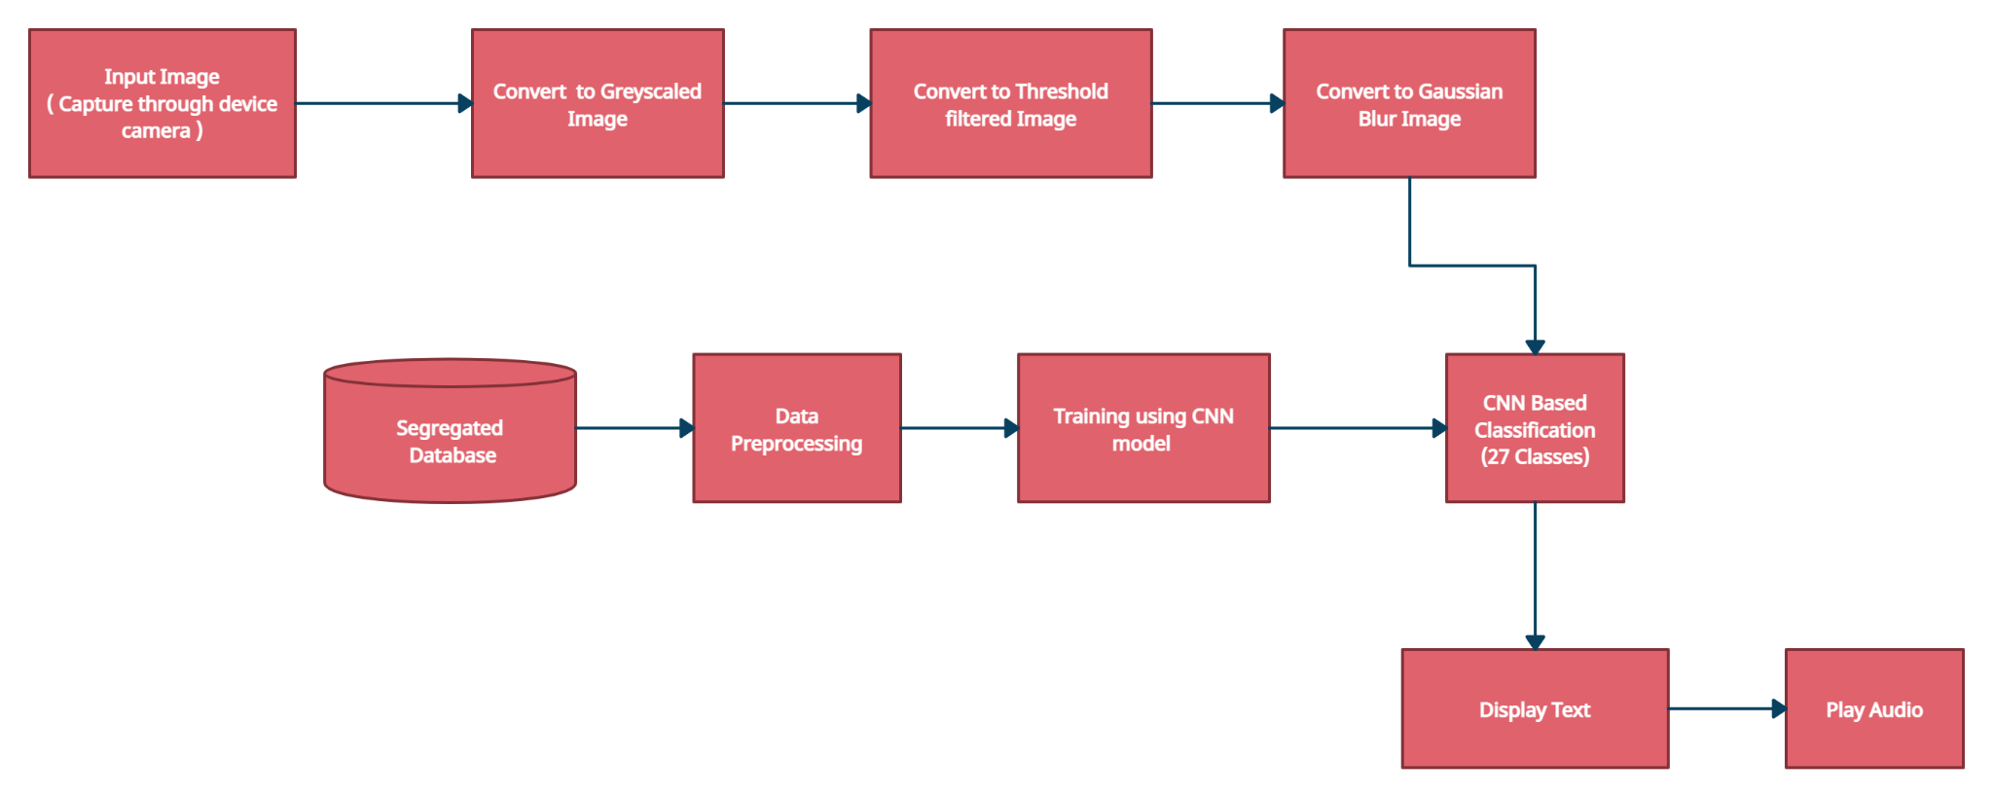
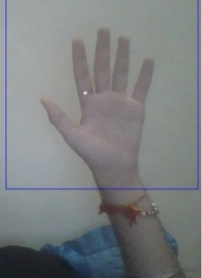
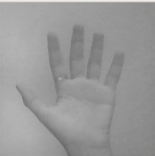
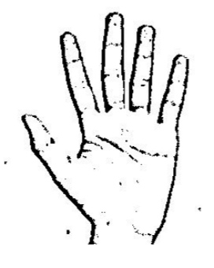

Design

Slide 7
Implementation
Completed with Data collection using OpenCV and captured 1001 images for each alphabet.
Completed data preprocessing using OpenCV filters and converted RGB images into gaussian blur.
Divided preprocessed images into training and testing with 70:30 ratio by using the technique of Random Sampling.
Created a CNN model which includes Convolutional-2D, Max-Pooling, Drop-out Layers,etc.
Finally completed the project with front end with TkInter in python.

Slide 8
Results
Validation Accuracy :- 98.83%
Training Accuracy :- 94.92%
Validation Loss :- 4.4%
Training Loss ;- 16.07%

Slide 9
Conclusion
We have achieve final accuracy of 98.74 percent on our data set. We would be able to improve our prediction after implementing two layers of algorithms in which we verify and predict symbols which are more similar to each other. This way we are able to detect almost all the symbols provided that they are shown properly, there is no noise in the background and lighting is adequate.

Slide 10
Future Scope
We can make the application completely hands free using the OpenCV so that the user would not require to use the mouse and keyboard again and again.
We can provide support of multiple language using the techniques of natural language processing.
If in case application could not be able to perform in certain conditions than we can have a wide community of people as volunteer the conversion of sign language live.
We can provide a support for the words that can be defined with the help of stream of signs rather than a single sign at a time.
As our application uses the technique of finger spelling for sign language we can upgrade our application so that it can support other form sign languages as well.

Slide 11
Cost Analysis
With an aim to develop the project using open source tools, no major cost.

Slide 12
References
T. Yang, Y. Xu, and “A. , Hidden Markov Model for Gesture Recognition”, CMU-RI-TR-94 10, Robotics Institute, Carnegie Mellon Univ.,Pittsburgh,PA, May 1994.
Pujan Ziaie, Thomas M ̈uller , Mary Ellen Foster , and Alois Knoll“A Na ̈ıve Bayes Munich,Dept. of Informatics VI, Robotics and Embedded Systems,Boltzmannstr. 3, DE-85748 Garching, Germany.
Pigou L., Dieleman S., Kindermans PJ., Schrauwen B. (2015) Sign Language Recognition Using Convolutional Neural Networks. In: Agapito L., Bronstein M., Rother C. (eds) Computer Vision - ECCV 2014 Workshops. ECCV 2014. Lecture Notes in Computer Science, vol 8925. Springer, Cham
Zaki, M.M., Shaheen, S.I.: Sign language recognition using a combination of new vision based features. Pattern Recognition Letters 32(4), 572–577 (2011)

Slide 13
THANK YOU !!

